Slide 1
Telecom Customers Churn
By : Mohamed Abdelkader
Omar Sabri Marwan Ashref Farag

Slide 2
The Outlines :
Import The Libraries
Load The Dataset
EDA
Feature Engineering
Modeling
Clustering
Hierarchical Clustering
PCA

Slide 3
The Problems we faced :
The first problem we faced was feature extraction: deciding which columns to use.
The second problem was encoding the object columns.
The third problem was improving the accuracy.

Slide 4
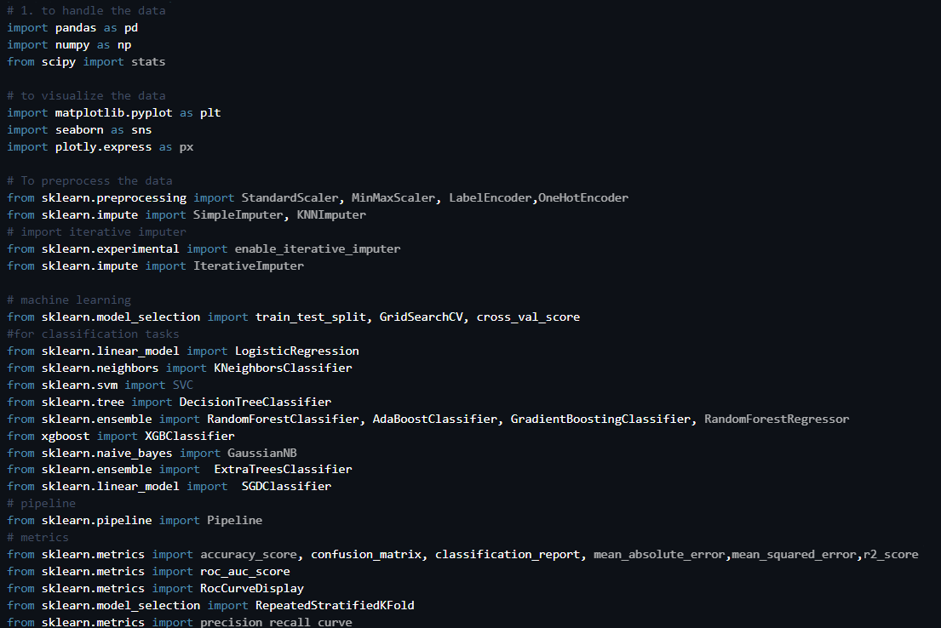
1) The Libraries :

Slide 5
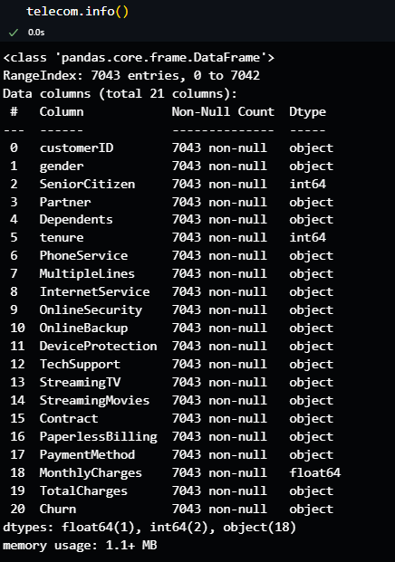
2 ) Load The Data :
Here we wrote the [info()] to see all the information about our dataset , we noticed that the shape of the data is (7043 , 12) and 1 column float ,2 columns integer and 18 columns is object .

Slide 6
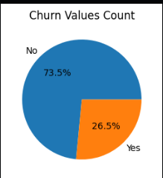
3 ) EDA
This image shows us two colorful pie charts. The first one is about customer churn - it tells us that most customers (73.5%) are sticking around, while about a quarter (26.5%) are leaving which mean that there are in imbalance in the data.

Slide 7
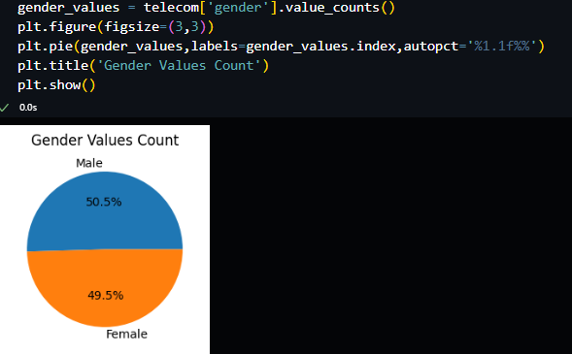
3 ) EDA
The second chart is about gender, showing it's pretty much split down the middle between men and women customers which mean that there are a balance in that column

Slide 8
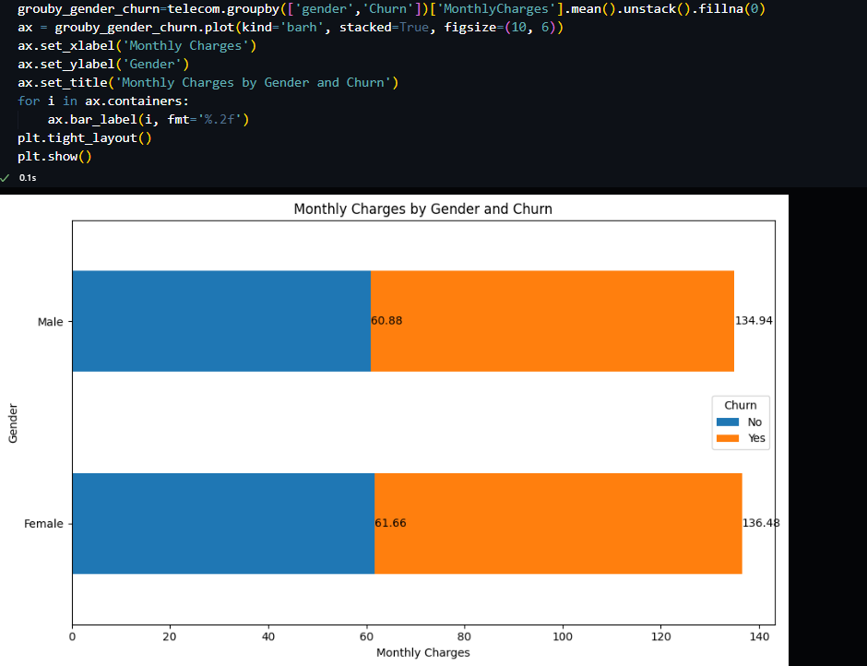
3) EDA
This image is a bar chart comparing how much men and women pay monthly, and whether they're likely to leave (churn) or stay. It's interesting because it shows that customers who leave tend to pay more, regardless of gender. The difference is pretty big too - about twice as much!

Slide 9
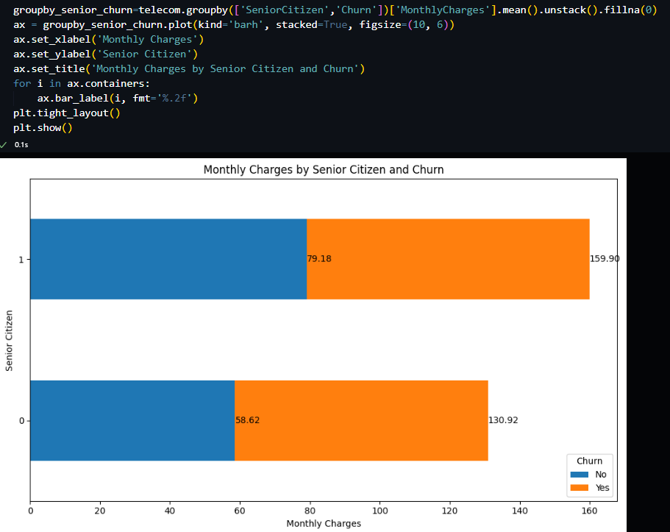
3)EDA
This image is similar, but it's comparing senior citizens to everyone else. Again, we see that people who leave are paying a lot more, and this is true for both groups. Senior citizens who leave are paying the most of all.

Slide 10
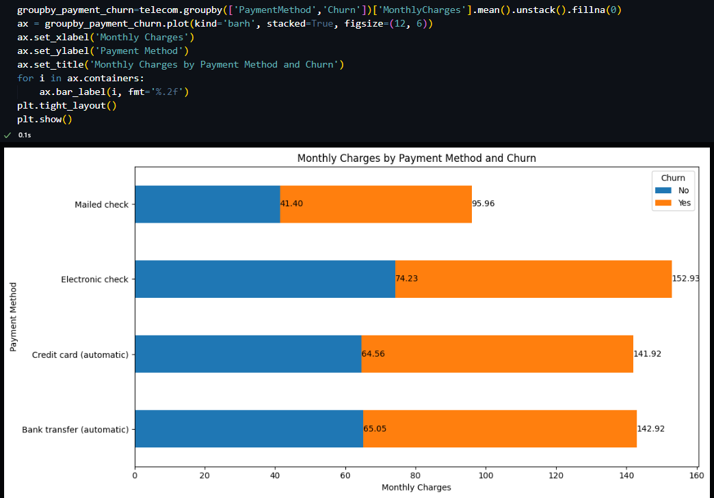
3)EDA
This visualization helps in understanding how payment methods relate to monthly charges and customer churn, which could be valuable for a telecom company's customer retention strategies.

Slide 11
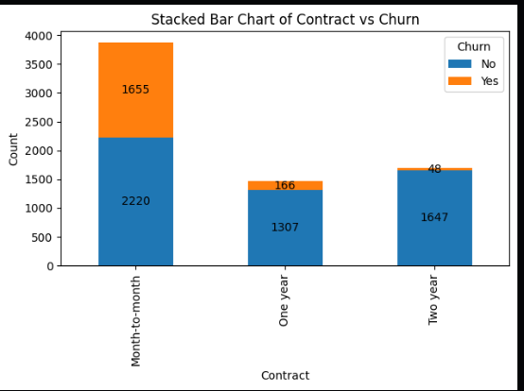
3)EDA
This visualization suggests that longer-term contracts are more effective at retaining customers, while month-to-month contracts, despite being popular, are more prone to customer churn.

Slide 12
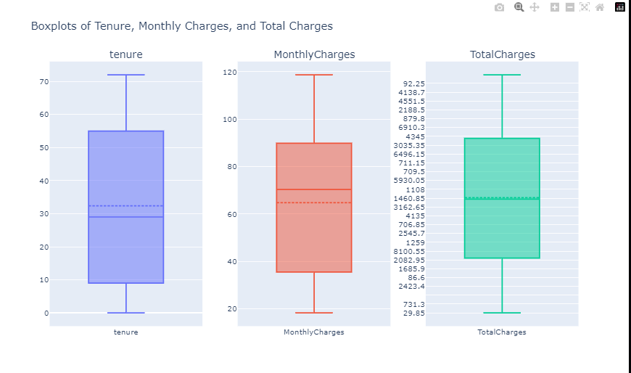
3) EDA
This visualize aim to detect the outliers by ploty library

Slide 13
Feature Engineering
Part -1

Slide 14
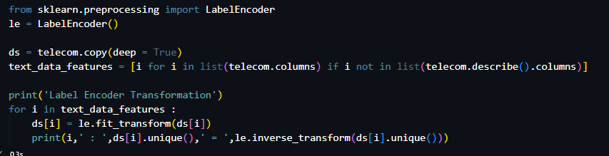
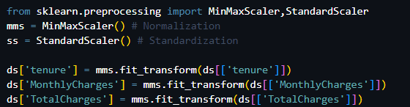
4) Feature Engineering
1) This code aim to encoding the categorical
columns to numerical by [Label Encoder]
2) This code aim to normalize the numerical columns by [MinMix Scaler]

Slide 15
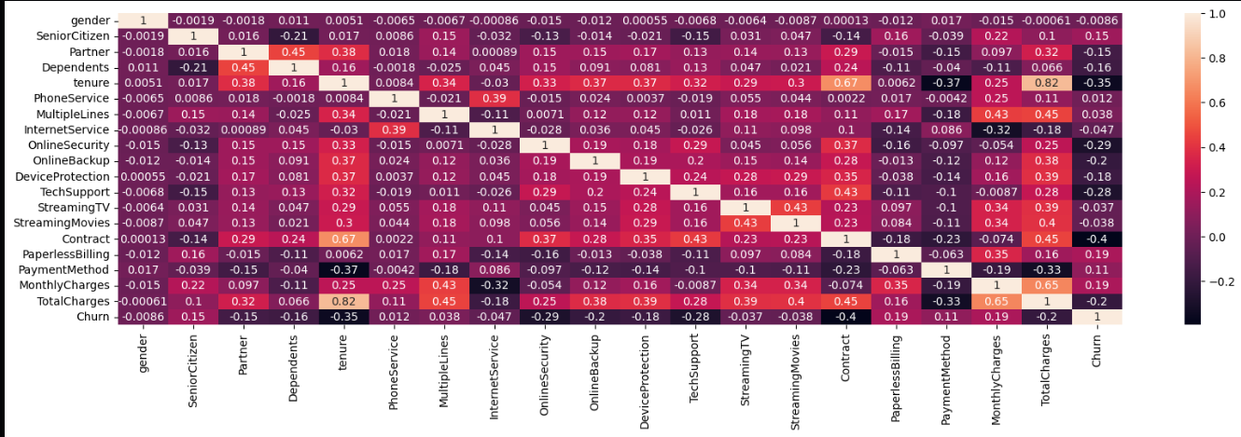
4)Feature Engineering
This is the correlation matrix after encoding and normalize the data

Slide 16
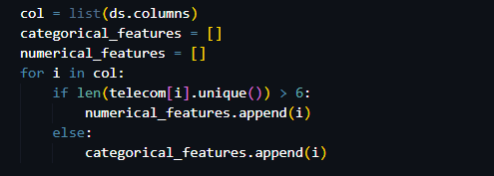
4) Feature Engineering
This Code aim to sperate the catigorical columns and the numerical columns to know the importance of each column to the target column

Slide 17
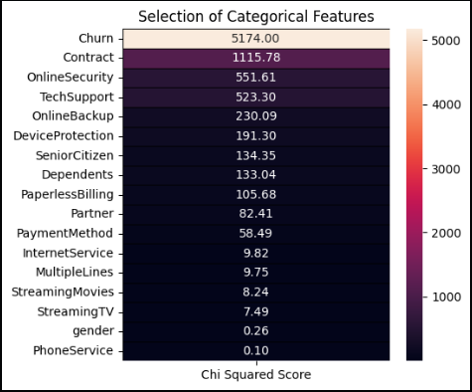
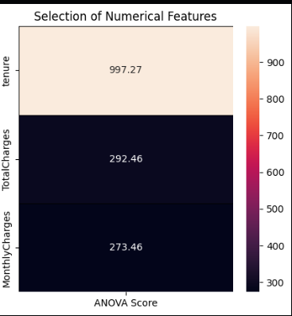
4)Feature Engineering
And here is the results
So we dropped Some columns :
['PhoneService', 'gender','StreamingTV','StreamingMovies','MultipleLines']

Slide 18
4) Feature Engineering
Part -2 : Feature Extraction

Slide 19
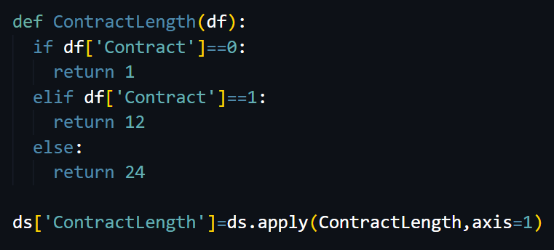
4 ) Feature Engineering
1) Monthly Charge With Tenure Feature
creates a new feature in the dataset that multiplies the monthly charges (MonthlyCharges) by the number of months the customer has been with the company (tenure).
By multiplying these two columns, the new feature MonthlyChargeWithTenure provides an estimate of the total amount the customer has been charged over the period of their tenure. This value may help to identify long-term customers who have been paying higher amounts, which could influence their likelihood of churning or staying with the company.
2) Contract Length Feature
Convert the Contract type into a numerical value to represent the length of the contract. Longer contracts might correlate with lower churn.

Slide 20
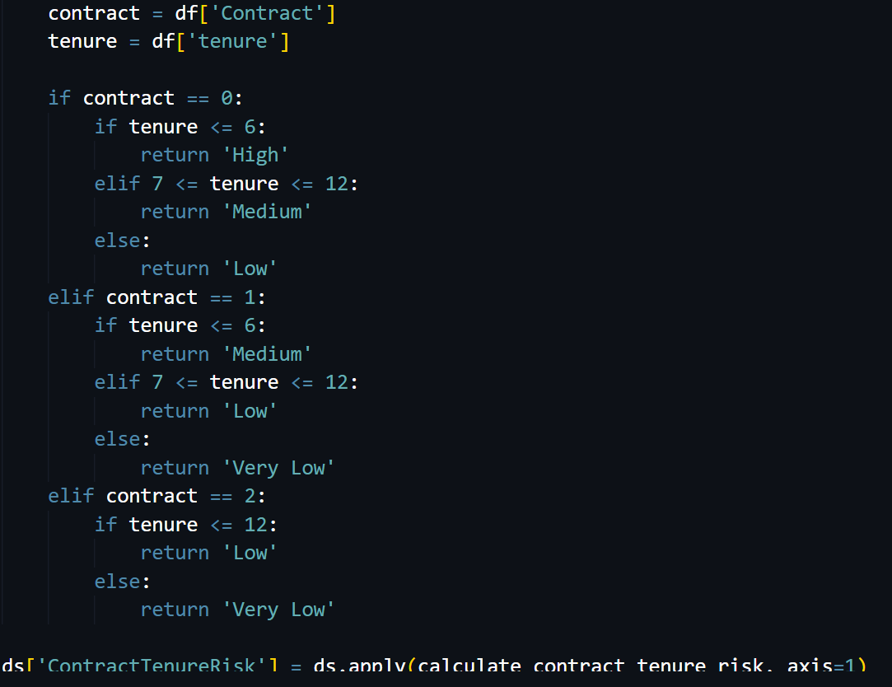
4) Feature Extraction
3) Contract Tenure Risk Feature
Create a new feature that reflects whether a customer is more likely to churn based on their contract type and tenure.
Month-to-month with low tenure could indicate high churn risk, while a two-year contract with long tenure might indicate low risk.

Slide 21
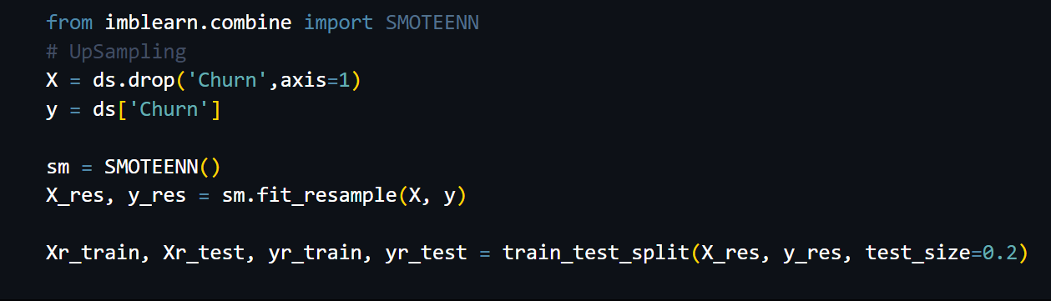
4) Feature Engineering
To solve the imbalance column [ Chrun] we used [SMOTEENN]
from imblearn library.

Slide 22
5) Modeling

Slide 23
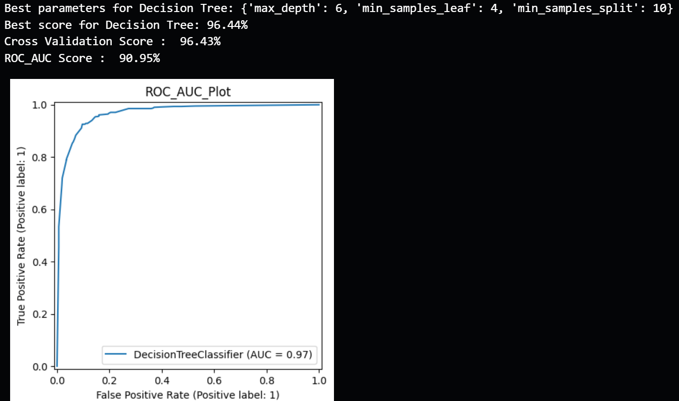
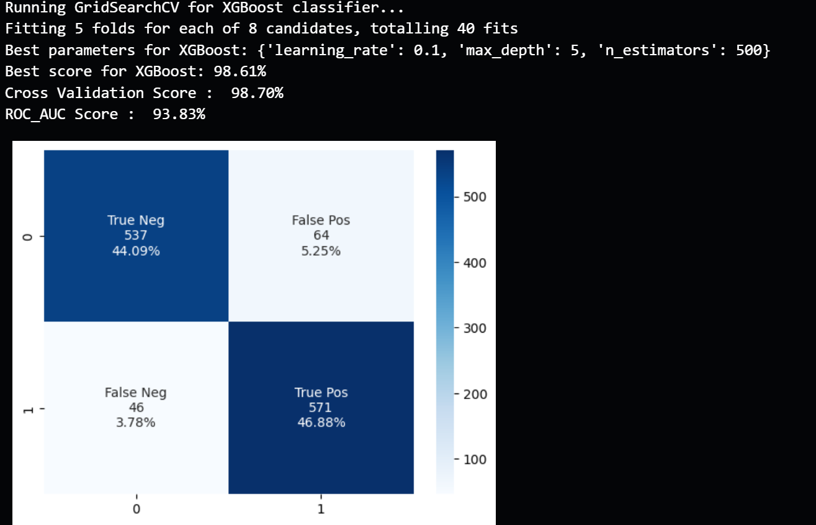
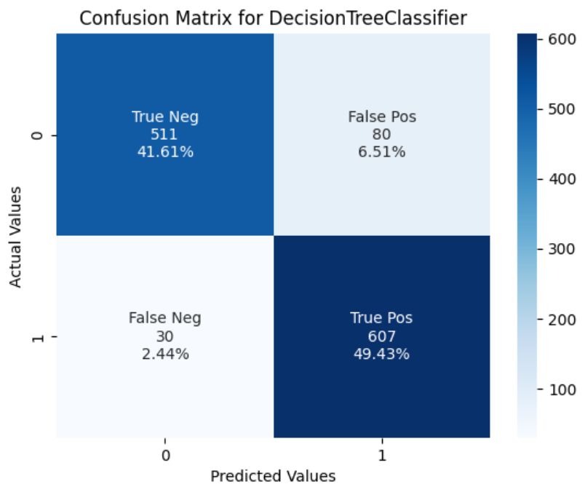
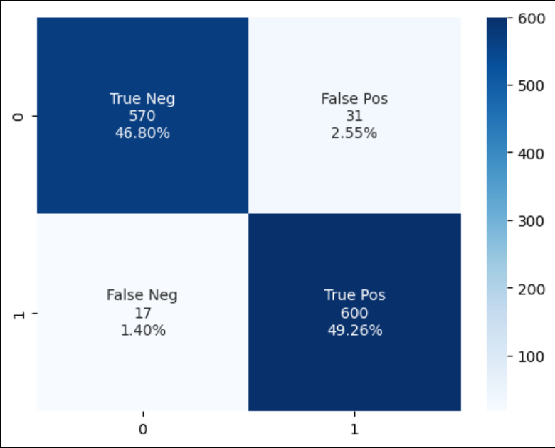
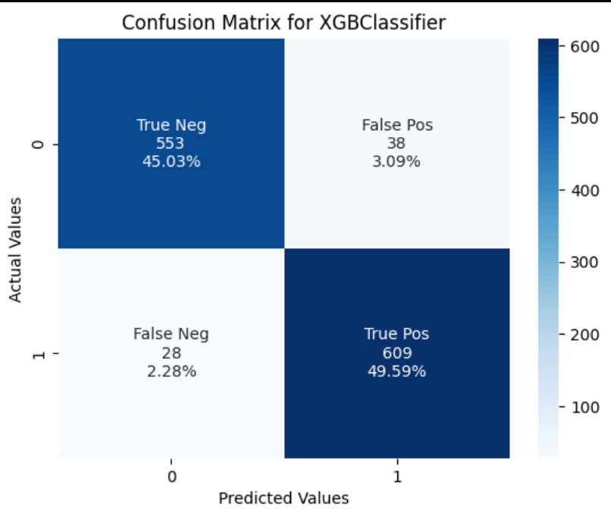
5) Modeling
We used to many models to see which one the best for this data , we used Decision Tree :
And XGBoost :

Slide 24
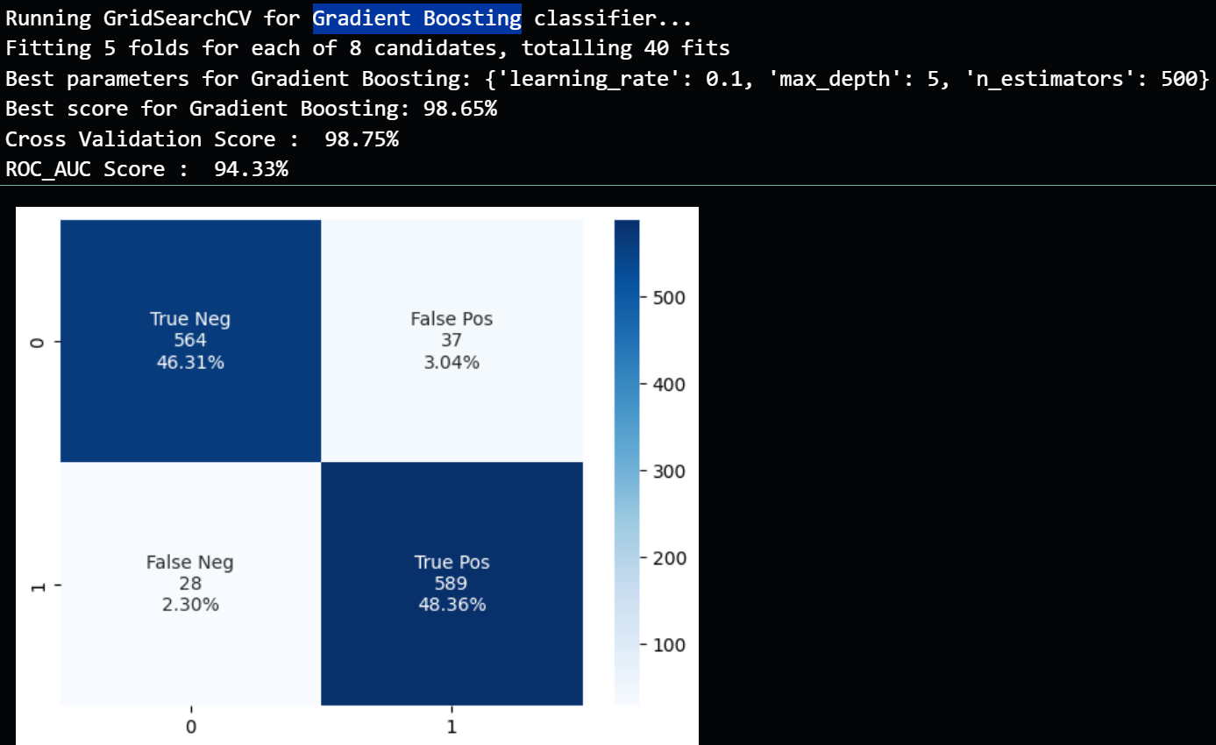
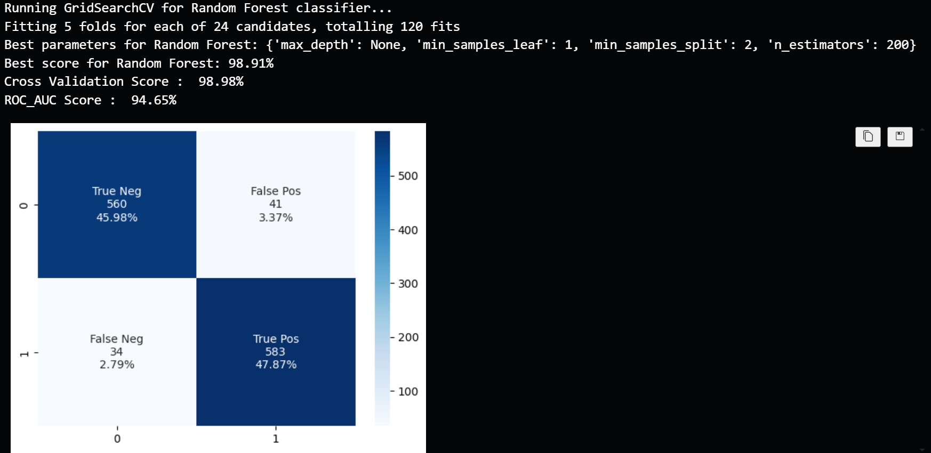
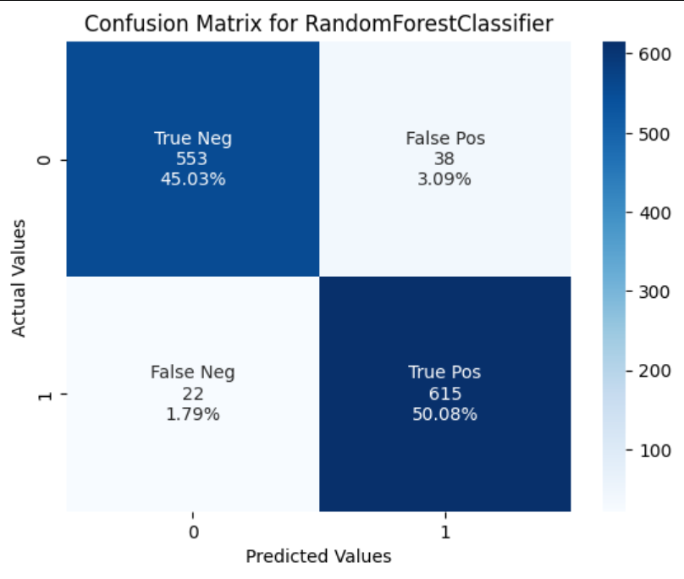
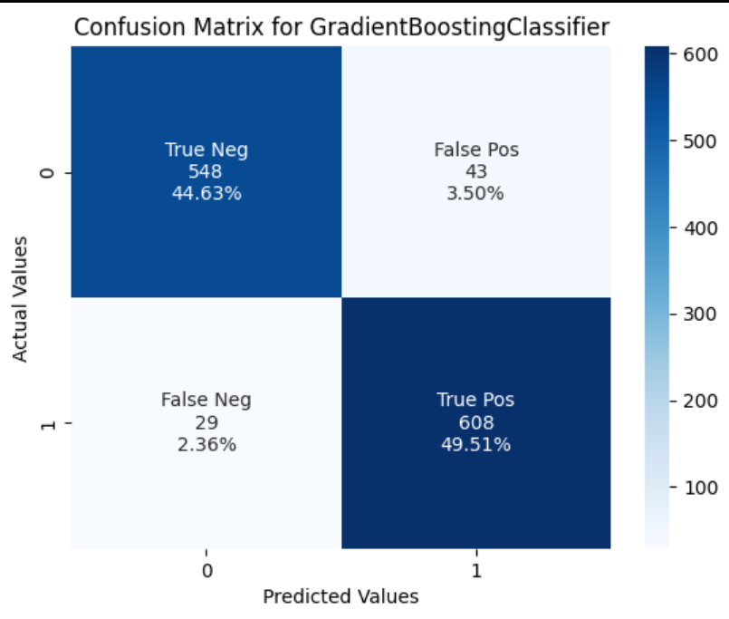
5) Modeling
3) Random forest :
4) Gradient Boosting :

Slide 25
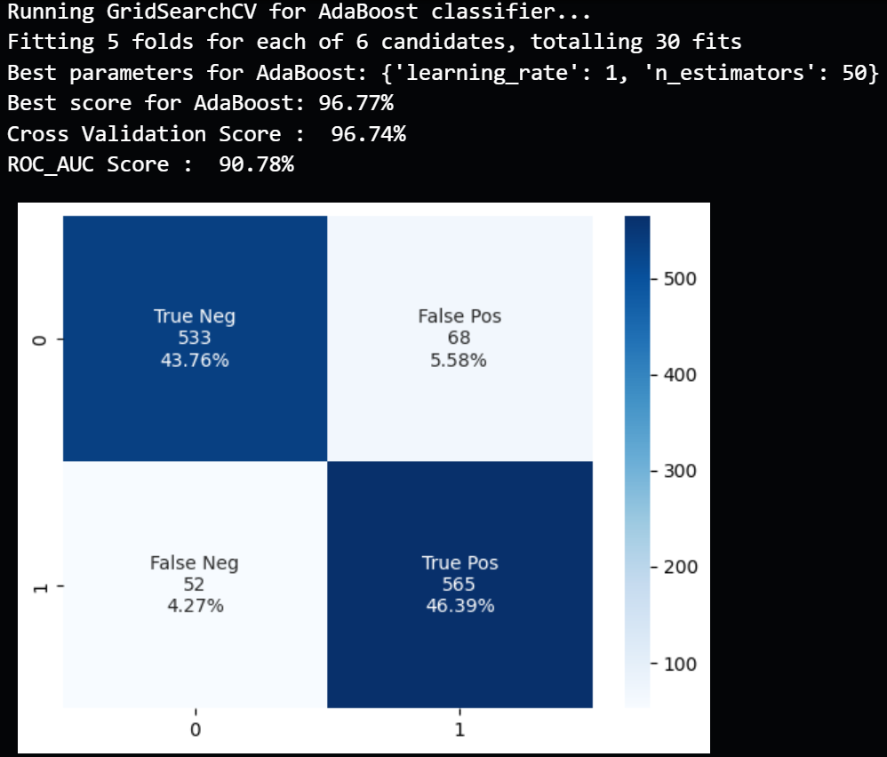
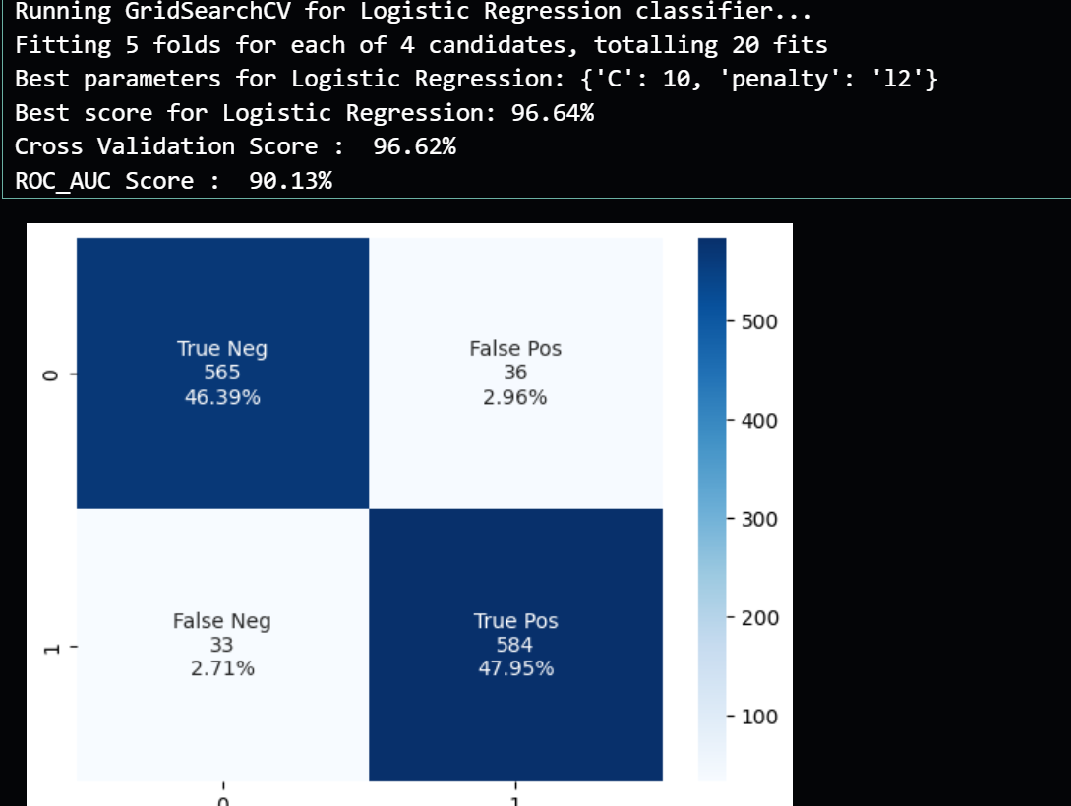


5) Modeling
5) Logistic Regression :
6) Ada Boost :

Slide 26
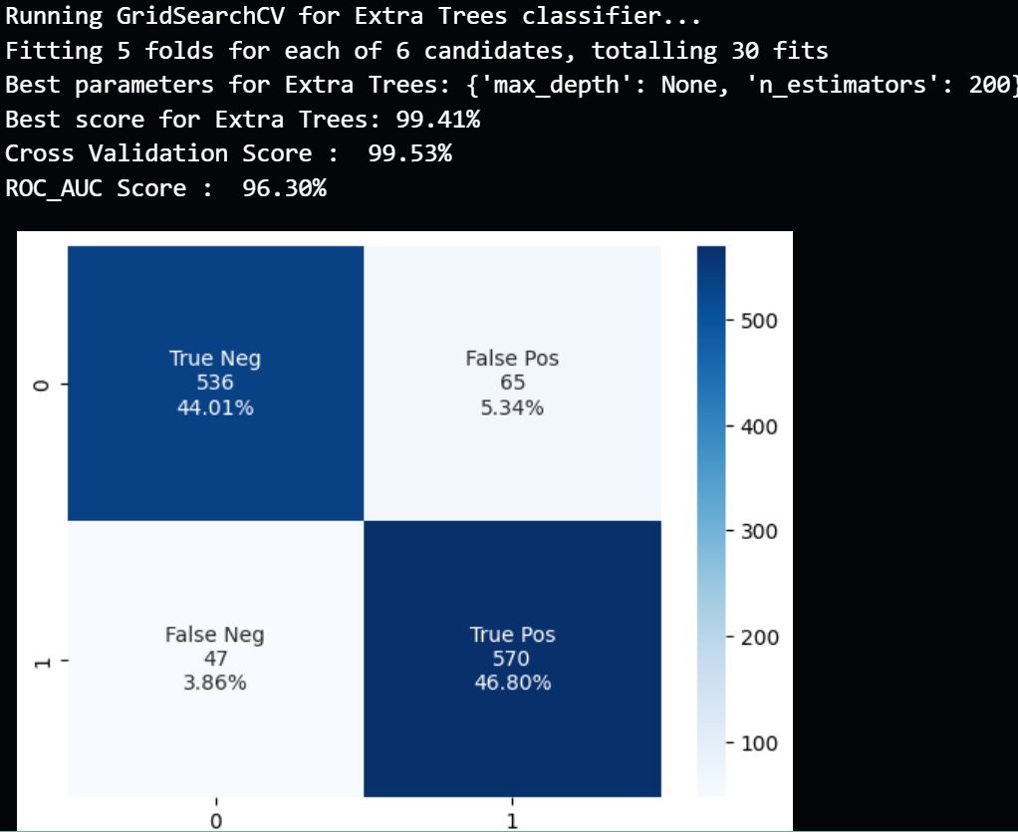
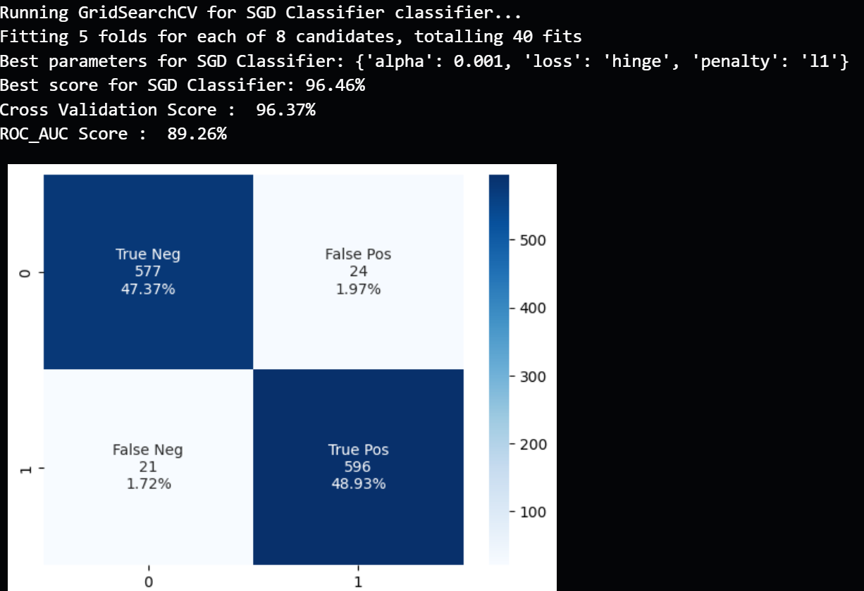

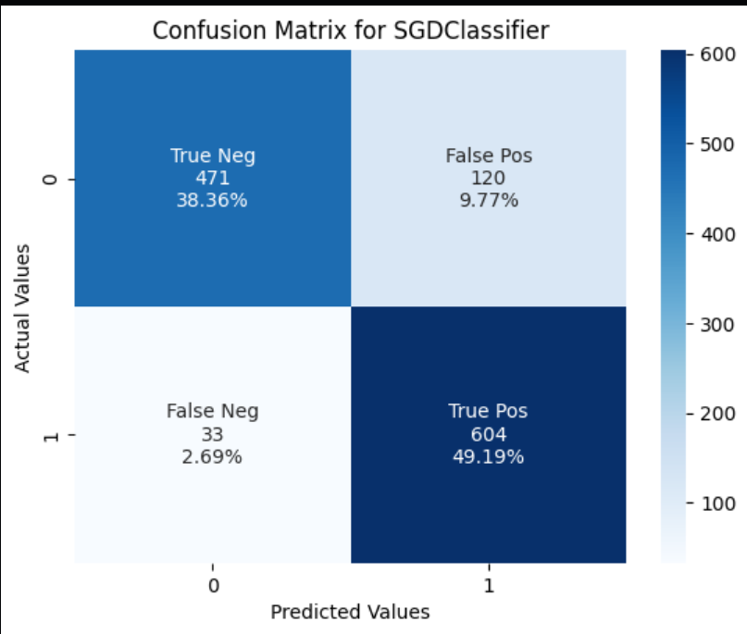
5) Modeling
7) Extra Trees classifier :
8) SGD Classifier :

Slide 27
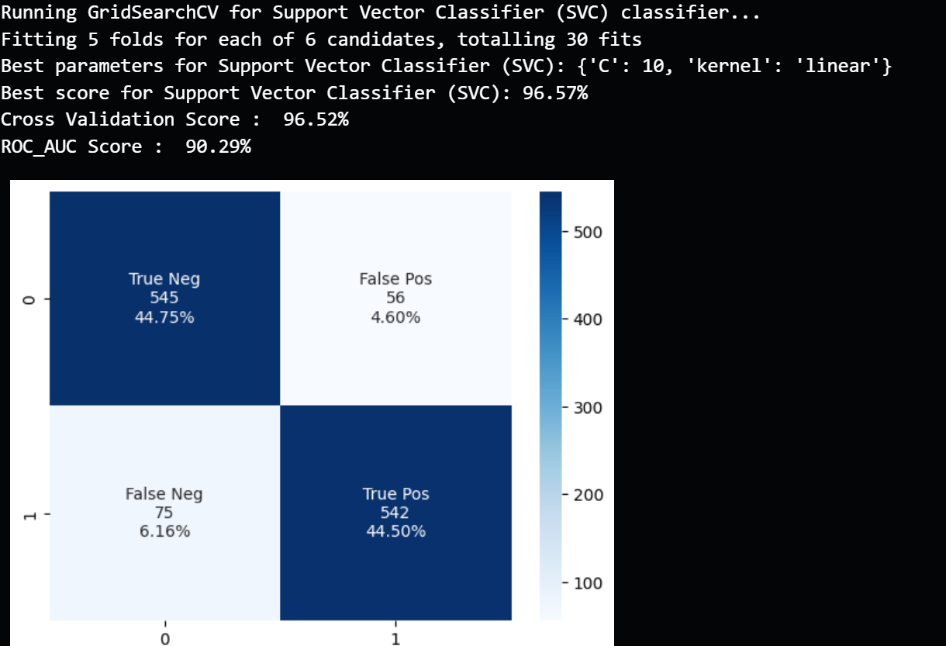
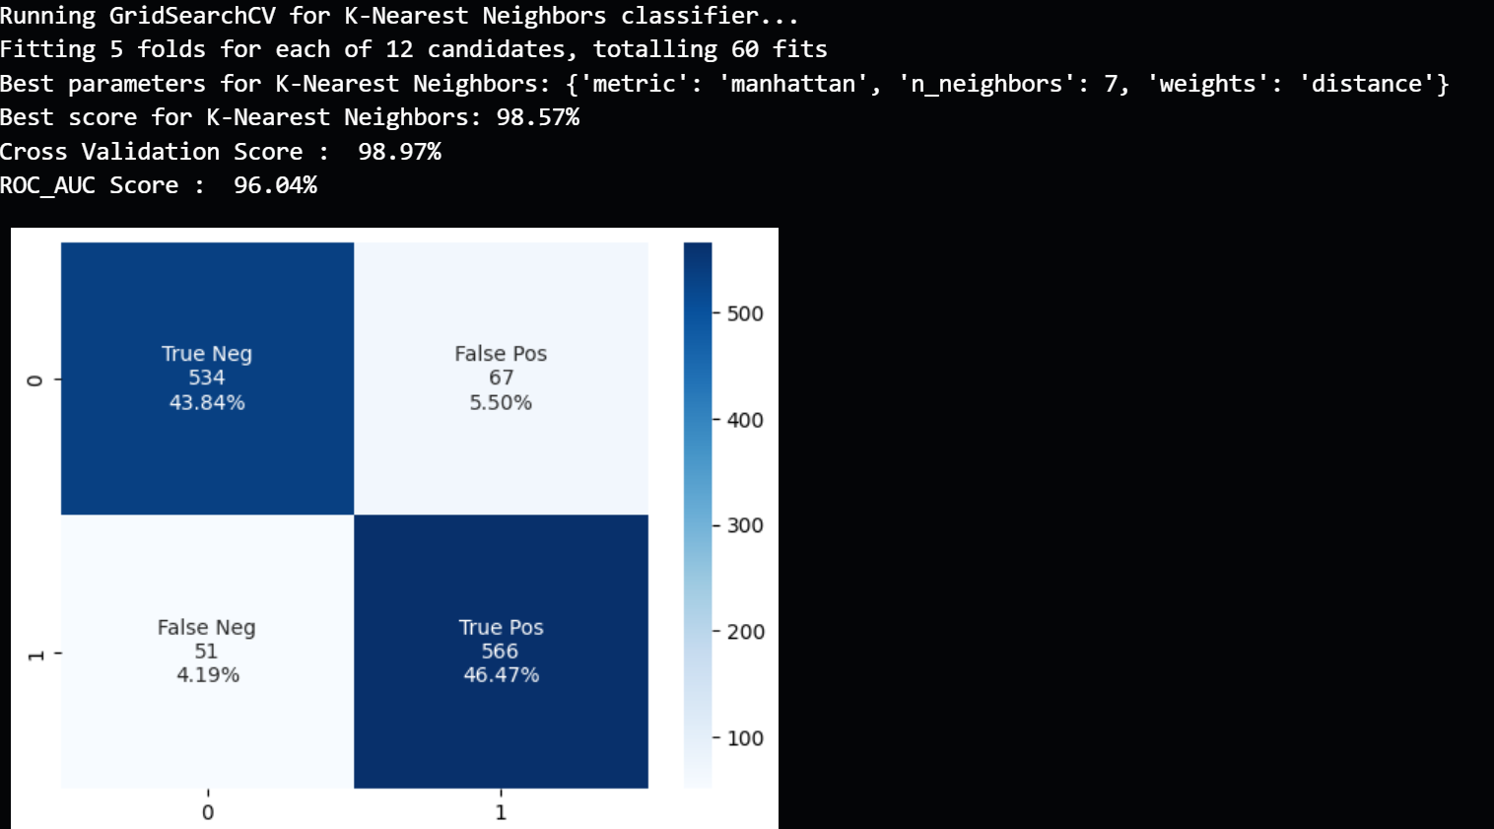
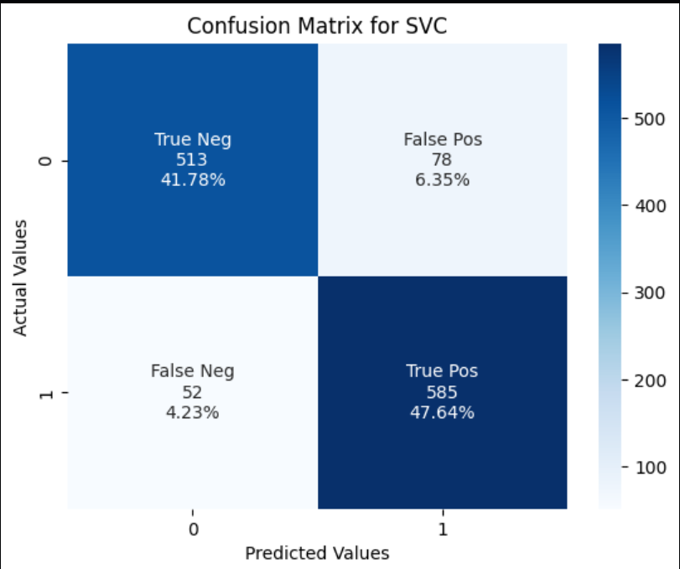

5) Modeling
9) SVC :
10) KNN :

Slide 28
6) Clustering

Slide 29
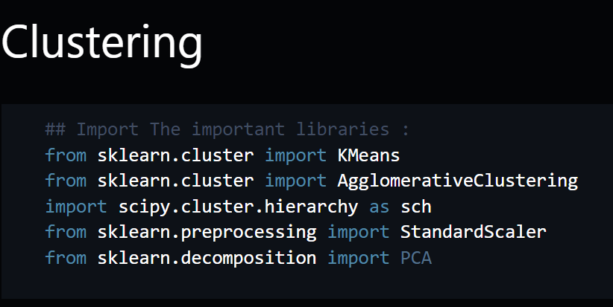
6) Clustering
Here is the libraries that used in the clustering

Slide 30
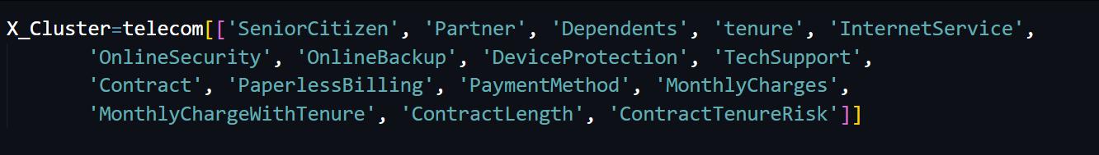
6 ) Clustering
This is the columns that we used it in the clustering

Slide 31
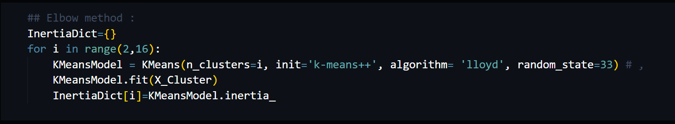
6) Clustering
This is the elbow method function that we created to get the optimal (n) for clustering

Slide 32
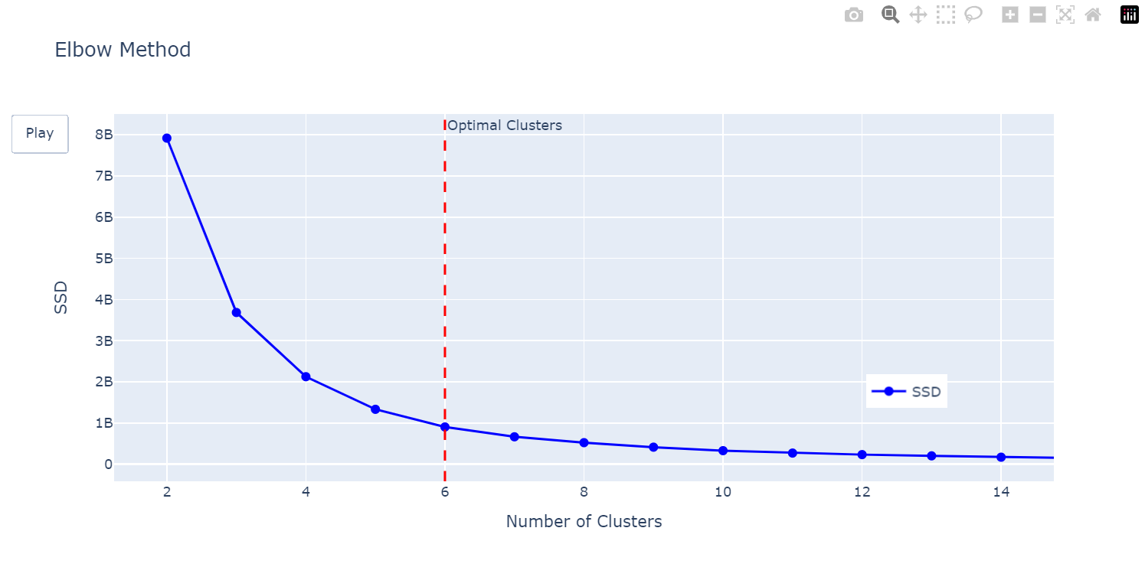
6) Clustering
And we found that the optimal (n) is 6

Slide 33
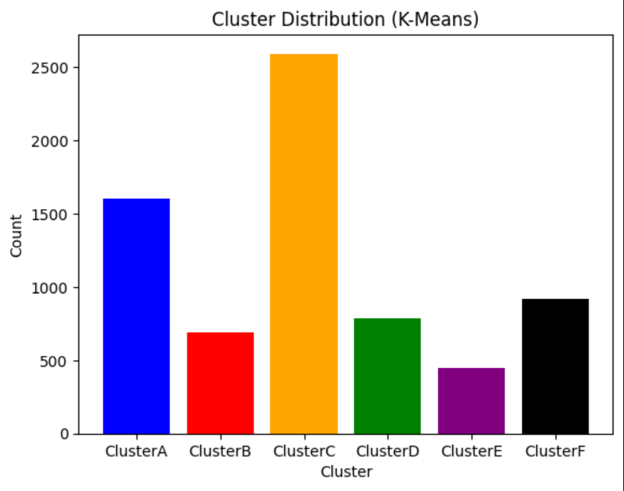
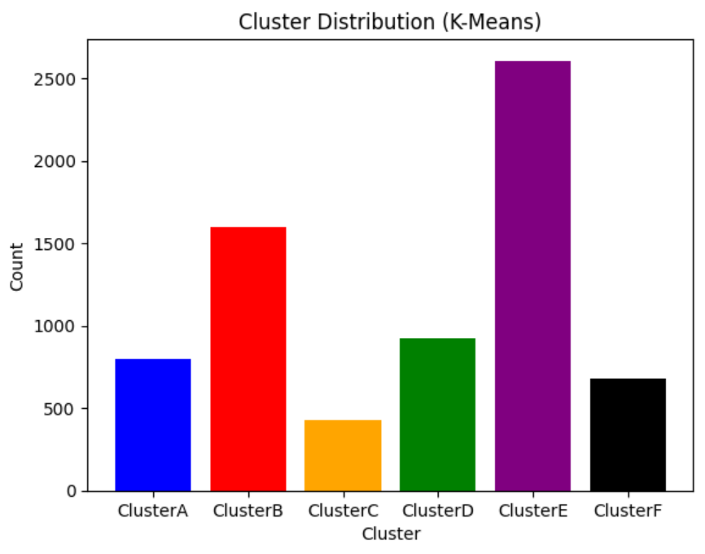
6) Clustering
This is the distribution for the 6 clusters :

Slide 34
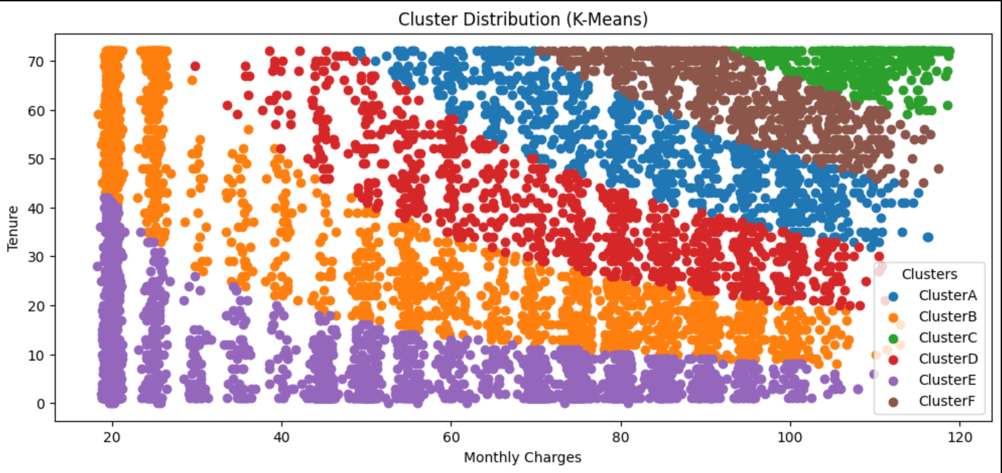
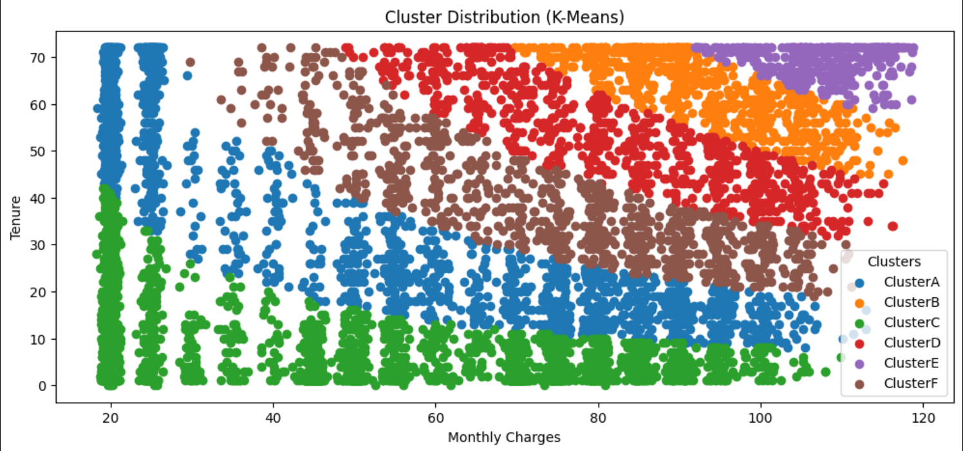
6) Clustering
And this is the cluster about monthlycharges & tenure which each one in a column :

Slide 35
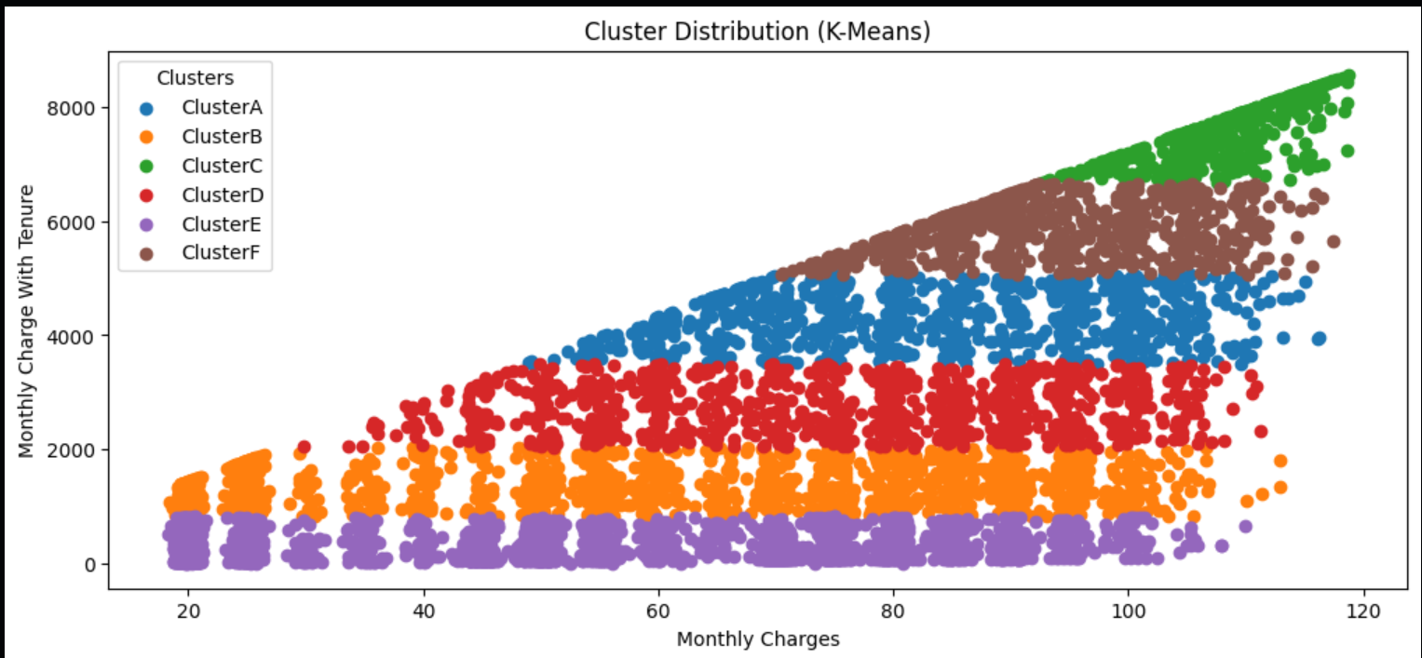
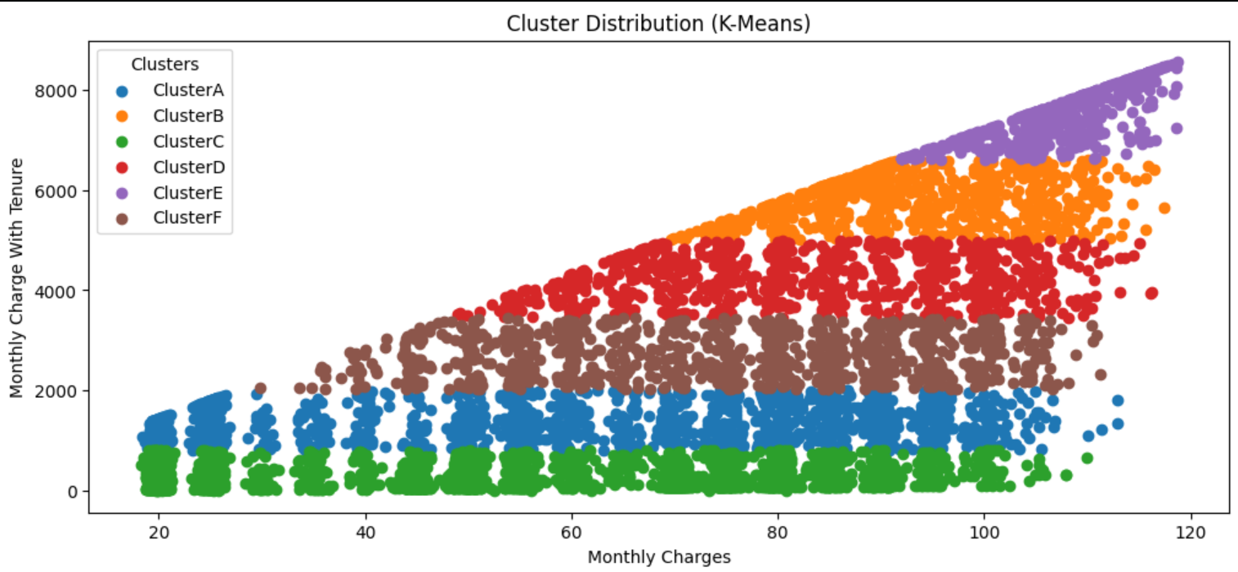
6) Clustering
And this is the cluster about monthlycharges & tenure in one column :

Slide 36
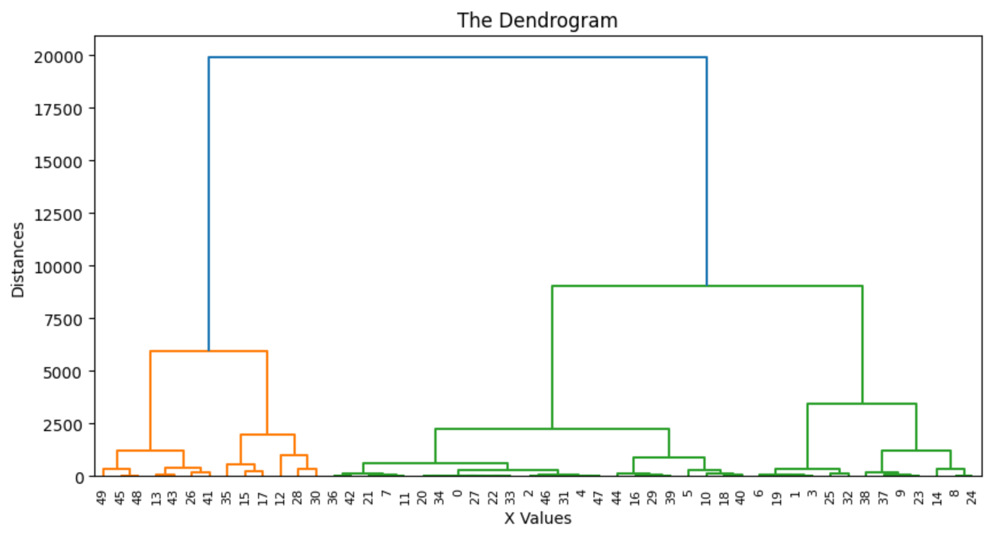
7) Hierarchical Clusters
This is the Hierarchical Clusters on this optimal number of clusters :

Slide 37
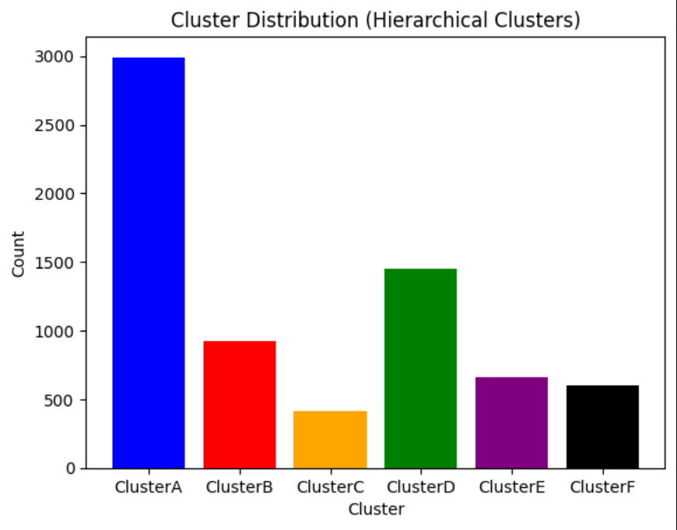
7) Hierarchical Clusters
And this is the distribution of the 6 clusters :

Slide 38
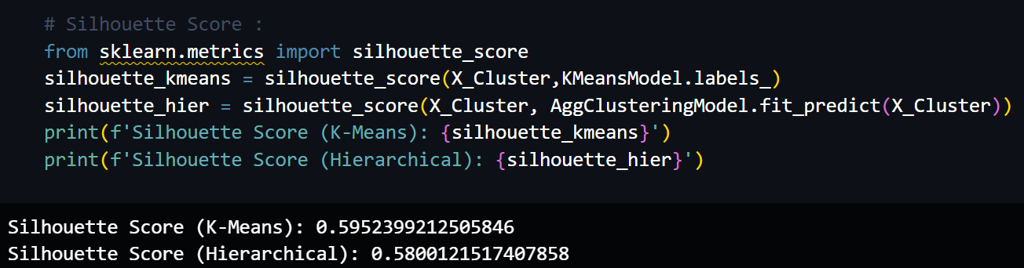
7) Hierarchical Clusters
This is a compression in the score between Kmeans & hierarchical cluster :

Slide 39
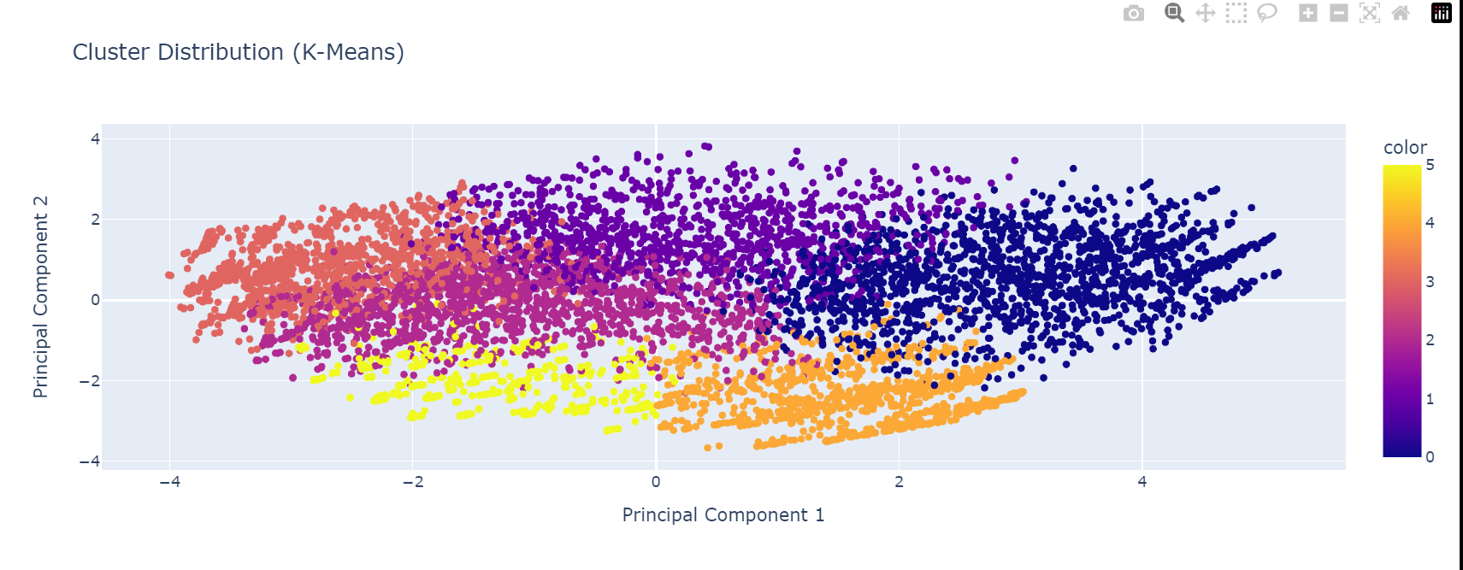
8) After using PCA
This is the results of k-means after using PCA:

Slide 40
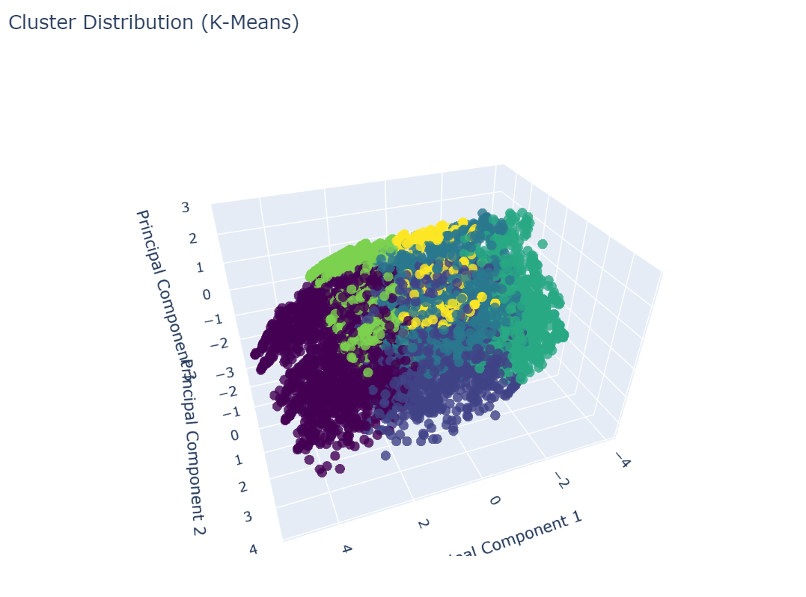
8) After using PCA
And this in the 3D :

Slide 41

8) After using PCA
And this is the results of Hierarchical clusters after using PCA :

Slide 42
Ending
THANK YOU ☺

